Slide 1
AI-Driven Collections Strategy & Delinquency Prediction
GenAI Powered Data Analytics Job Simulation for Tata Group

Slide 2
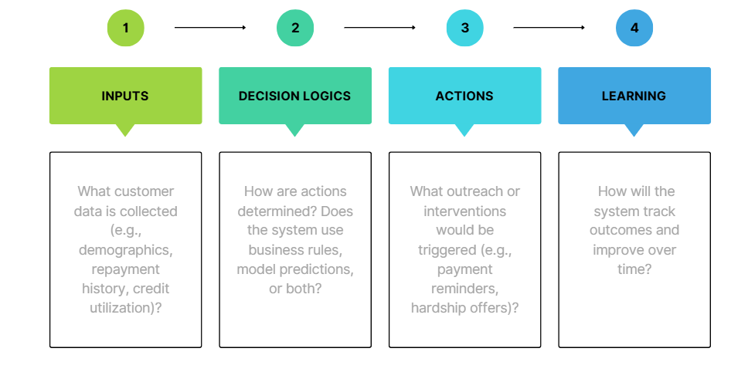
How the System Works
Customer Data & Insight Analysis: The process begins by analyzing specific "Customer Segments" and "Influencing Variables" to derive a "Key Insight" about customer behavior or needs.
Decision-Making (SMART Framework): The derived insight is restated and transformed into a "Proposed Recommendation" using the SMART approach to ensure it is Specific, Measurable, Actionable, Relevant, and Time-bound.

Slide 3
Action & Intervention: The business implements the specific, actionable intervention outlined in the recommendation framework to achieve the identified "Potential Impact".
Learning & Ethical Monitoring: The outcomes are measured against the defined goals, and the overall process is reviewed for ethical considerations, such as fairness, transparency, and accountability, to inform future decisions.

Slide 4
Role of Agentic AI
1. AI Governance & Role
Fully Automated: Handles high-volume, low-risk tasks (e.g., financial health reminders, educational videos).
Human-in-the-Loop: Financial advisors must approve high-impact actions like rate reductions, hardship plans, or restructuring.
2. Ethical Guardrails
Bias Prevention: Excludes proxies like zip code/education to prevent racial or gender discrimination.
Transparency: Uses feature importance (e.g., DTI scores) to explain risk flags to staff and customers.
Integrity: Prioritizes financial relief over new debt; uses anonymized data and mandatory oversight for credit-impacting decisions.

Slide 5
3. SMART Recommendation Framework
Core Insight: "Early Career" users with high DTI and missed utility bills have 3x higher default risk.
Recommendation: Launch a Financial Wellness Outreach program.
  Specific: Provide budgeting tools and a temporary 2-month interest rate cut.
  Measurable: Target a 15% reduction in segment defaults over six months.
  Actionable: Daily risk scoring triggers automated outreach or manual flags.
  Time-bound: 6-month pilot with a formal audit at Month 3.
Rationale: Early intervention is more cost-effective than legal recovery and builds long-term brand loyalty.

Slide 6
Responsible AI Guardrails
1. System Workflow: From Data to Action
Intake & Analysis: The system ingests customer data and identifies "Early Career" segments with high debt-to-income (DTI) ratios.
Decision (SMART Recommendation): Insights are converted into a "Financial Wellness Outreach" recommendation that is specific, measurable, and time-bound.
Action (Agentic AI): The system autonomously sends low-risk educational reminders while flagging high-impact hardship plans for human financial advisor approval.
Learning & Compliance: The system audits results for fairness and regulatory compliance (GDPR/ECOA) to improve future accuracy.

Slide 7
2. SMART Recommendation Framework
Insight: "Early Career" customers with high DTI and two missed utility payments carry a 3x higher default risk.
Proposed Recommendation: Launch an automated "Financial Wellness Outreach" program.
  Specific: Offer budgeting tools and a temporary 2-month interest rate reduction.
  Measurable: Target a 15% reduction in segment default rates within two quarters.
  Actionable: Use daily risk scores to trigger automated outreach or manual advisor review.
  Time-bound: Conduct a 6-month pilot with a performance audit at month three.
Business Rationale: Early prevention is significantly cheaper than legal recovery costs and write-offs, fostering long-term customer loyalty.
3. Expected Business Impact for Geldium
Quantitative: Reduced delinquency rates, increased repayment volumes, and lower operational costs due to automated high-volume outreach.
Qualitative: Enhanced customer trust through empathetic, transparent interventions and a scalable, fair strategy that treats customers consistently.

Slide 8
4. Responsible AI Guardrails
Automated Bias Monitoring: Continuously audit outputs to ensure proxies like "zip code" or "education level" do not cause disparate impact.
Explainability Requirements: Use feature importance (e.g., "High DTI") to provide transparent "reason codes" for every risk flag.
Human-in-the-Loop (HITL): Mandate human approval for any decision affecting a customer's credit standing, such as loan restructuring.
Regulatory Compliance: Ensure all data handling and automated decisions align with GDPR and ECOA standards.

Slide 9
Expected Business Impact
Business KPIs (Quantitative Outcomes)
Reduced Delinquency Rates: Anticipated 25%+ cut in loan delinquencies and a 10% reduction in 30-day delinquency through early detection of risk signals like missed utility payments.
Lower Operational Costs: Automation of routine tasks (e.g., SMS reminders, risk scoring) could reduce operational costs by up to 40% and eliminate 90%+ of manual collection efforts.
Improved Recovery Efficiency: Expectations of 10–25% higher debt recovery rates by prioritizing high-probability accounts and using algorithmic calling decisions that outperform manual methods by 23.4%.
Accelerated Cash Flow: Targeted reductions in Days Sales Outstanding (DSO) by 10–20 days, ensuring faster cash conversion and improved liquidity.

Slide 10
Customer Outcomes (Qualitative Results)
Enhanced Customer Experience: Transition to a less intrusive "empathetic" approach using perfect timing and preferred digital channels (SMS/Email) rather than disruptive calls.
Tailored Financial Solutions: Provision of hyper-personalized repayment plans and hardship offers that fit a customer's specific budget, leading to reported 25–30% boosts in satisfaction ratings.
Increased Fairness and Trust: Use of explainable, data-driven interventions and bias monitoring to ensure fair treatment across all demographic segments.
Scalability and Sustainability: The ability to handle increased workloads and diverse customer personas (e.g., small businesses vs. individuals) without a proportional increase in headcount.

